Slide 1
463.8 Crypto Models
Computer Security II
CS463/ECE424
University of Illinois
Notes:
These slides are based on Chapters 1 and 2 and sections 3.1-3.3 of the book: "Introduction to modern cryptography“ by Jonathan Katz, and Yehuda Lindell. CRC Press, 2014.

Slide 2
Outline
Principles of Modern Cryptography
Perfectly Secret Encryption
Computational Security
Pseudorandom Generators
Katz and Lindell, Introduction to Modern Cryptography 2014

Slide 3
463.8.1 Principles of Modern Cryptography
Computer Security II
CS463/ECE424
University of Illinois

Slide 4







Secure Communication
Private-key (symmetric-key) setting
plaintext
ciphertext
plaintext
Encryption$k$
Decryption$k$
Alice
Bob
Eve

Slide 5
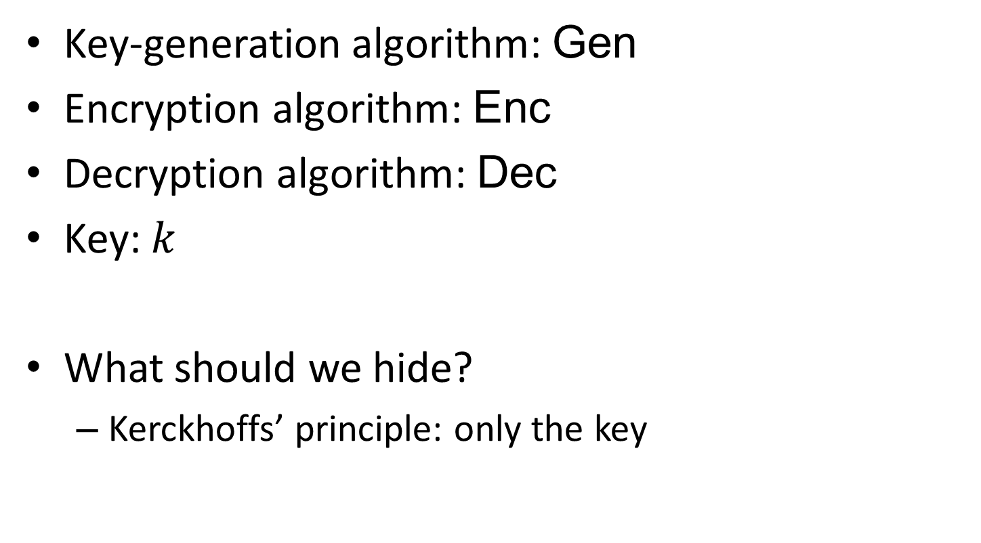
Components
Key-generation algorithm: Gen
Encryption algorithm: Enc
Decryption algorithm: Dec
Key: $k$
What should we hide?
Kerckhoffs’ principle: only the key

Slide 6
Kerckhoffs’ Principle
“A cryptosystem should be secure even if everything about the system, except the key, is public knowledge.” – Auguste Kerckhoffs
In other words: the security should be based only on the secrecy of the key
In contrast with the idea of “security by obscurity”

Slide 7
Kerckhoffs’ Principle
Easier to exchange a (short) key than maintain secrecy of the algorithms
If key is leaked, it can be changed easily, whereas changing algorithms is cumbersome.
(Good practice to change key periodically.)
Everyone uses the same algorithms, and different parties can use different keys to communicate

Slide 8
Open cryptographic designs?
Public scrutiny increases confidence in the strength of the algorithms
Better if “ethical hackers” reveal flaws
If cryptosystems are secret, they can be reverse-engineered
Standards can be established

Slide 9
Attack Scenarios
Ciphertext-only attacks
Known-plaintext attacks
Chosen-plaintext attacks
Chosen-ciphertext attacks
Notes:
Ciphertext-only attacks: attacker knows ciphertexts, tries to decrypt them, or recover the key.
Known-plaintext attacks: attacker has a set of plaintext – ciphertext pairs, tries to recover the key, or decrypt *some other* ciphertext.
Chosen-plaintext attacks: attacker has is able to chose a plaintext and obtain the corresponding ciphertext (encrypted under an unknown key).
Chosen-ciphertext attacks: attacker can obtain the decryption of any ciphertext (under an unknown key).

Slide 10
Historical Ciphers
Caesar’s Cipher, ROT-13, Vigenère Cipher
These and others were all broken
E.g., through frequency analysis
Historically, designing ciphers was more like an art than a science

Slide 11
Three Key Principles of Modern Cryptography
Formulation of exact definitions
Reliance on precise assumptions
Rigorous proofs of security

Slide 12
1. Formulation of exact definitions
Designing cryptosystems
What do we want to achieve?
Using cryptosystems
What encryption scheme suffices for an application?
Studying cryptosystems
How can we compare two different encryption schemes?

Slide 13
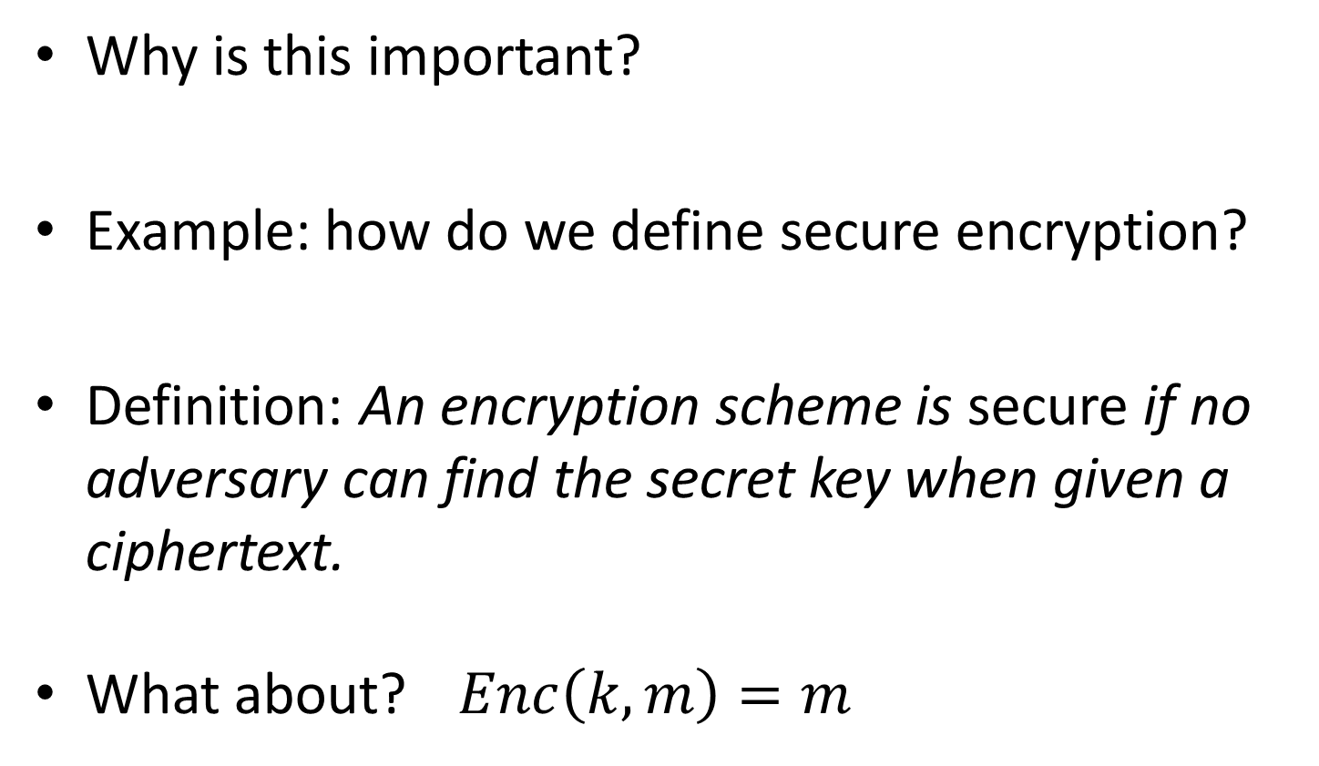
1. Formulation of exact definitions
Why is this important?
Example: how do we define secure encryption?
Definition: An encryption scheme is secure if no adversary can find the secret key when given a ciphertext.
What about? $Enc\left(k, m\right)=m$

Slide 14
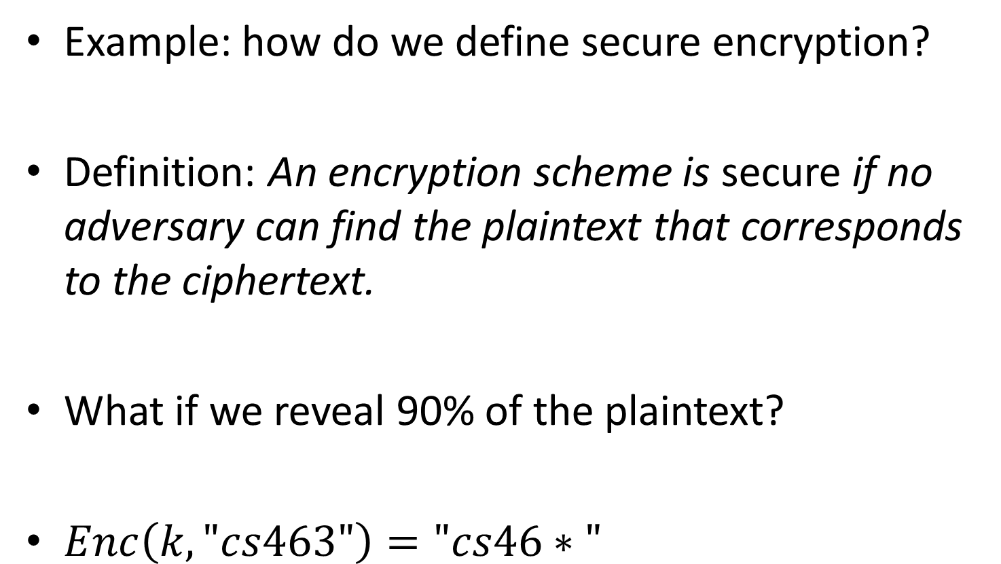
1. Formulation of exact definitions
Example: how do we define secure encryption?
Definition: An encryption scheme is secure if no adversary can find the plaintext that corresponds to the ciphertext.
What if we reveal 90% of the plaintext?
$Enc\left(k, "cs463"\right)="cs46∗"$

Slide 15
1. Formulation of exact definitions
Example: how do we define secure encryption?
Definition: An encryption scheme is secure if no adversary can determine any character of the plaintext that corresponds to the ciphertext.
Suppose we encrypt someone’s salary
What if the scheme reveals whether that salary is more than $100,000?

Slide 16
1. Formulation of exact definitions
Example: how do we define secure encryption?
Definition: An encryption scheme is secure if no adversary can derive any meaningful information about the plaintext from the ciphertext.
What is “meaningful”? Is learning part of the plaintext meaningful?

Slide 17
1. Formulation of exact definitions
Example: how do we define secure encryption?
Definition: An encryption scheme is secure if no adversary can compute any function of the plaintext from the ciphertext.
Close to the “right” definition, but does not specify the attacker model, e.g., adversary’s computing power

Slide 18
2. Reliance on precise assumptions
Modern cryptographic schemes can only be proved secure under some assumptions
Security relies on an adversaries inability to solve certain hard problems
These problems are often assumed to be hard

Slide 19


2. Reliance on precise assumptions – Illustration with RSA
p and q large primes, N = pq, φ =(p-1)(q-1),
Take e co-prime with φ,
Compute d = e⁻¹ mod φ,
The public key is K = (N,e) and the private key is K’ = (N, d)
Alice
K ← (N, e)
Bob
Message m
c ← m^{e} mod N
Decryption
m = c^{d} mod N

Slide 20
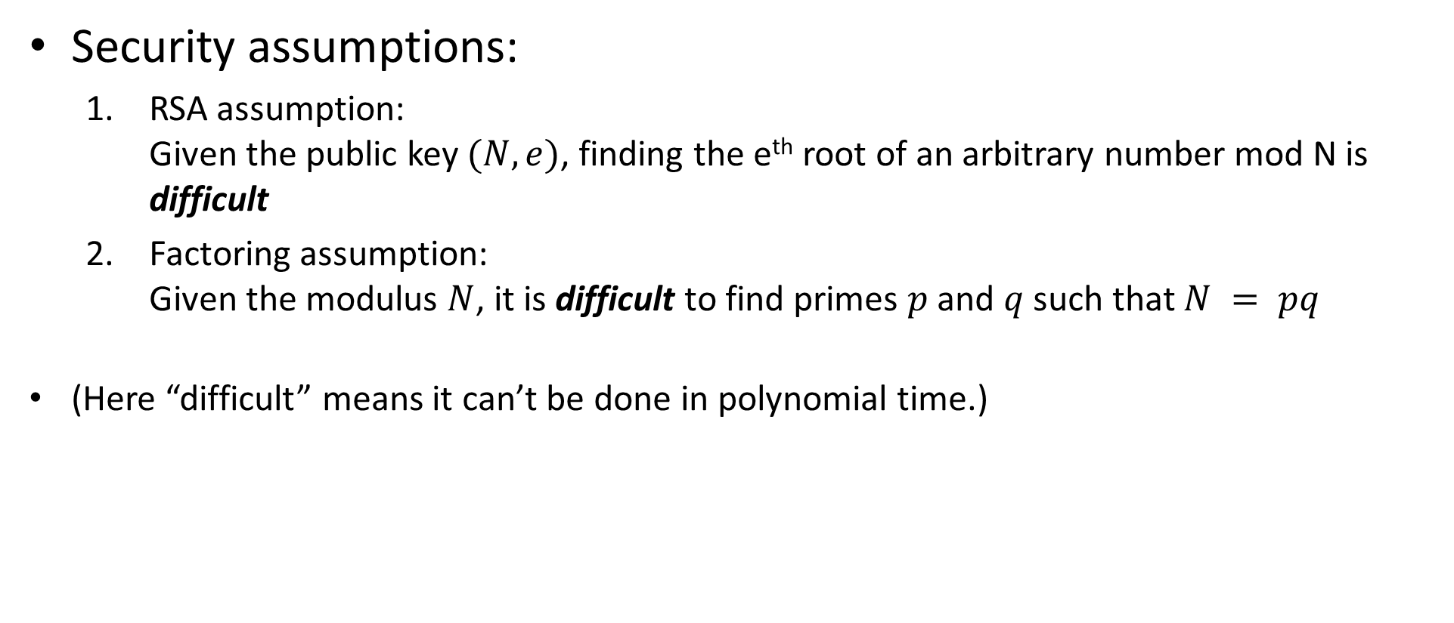
2. Reliance on precise assumptions – Illustration with RSA
Security assumptions:
RSA assumption: Given the public key $(N, e)$, finding the e^{th} root of an arbitrary number mod N is difficult
Factoring assumption: Given the modulus $N$, it is difficult to find primes $p$ and $q$ such that $N = pq$
(Here “difficult” means it can’t be done in polynomial time.)

Slide 21
2. Reliance on precise assumptions
Validity:
The more an assumption is studied without being refuted, the more confident we are that it is true
We can provide evidence that the assumption is true by showing it is implied by some other (accepted) assumption
Assumption needs to be precisely stated to be studied
Notes:
- e.g., computing square-roots in Z_N is equivalent to factoring

Slide 22
2. Reliance on precise assumptions
Comparison of cryptographic schemes:
Two schemes A and B have same efficiency, but A depends on an assumption implied by B’s assumption
Then A is better
If the assumptions are incomparable, then we give preference to better studied assumptions

Slide 23
2. Reliance on precise assumptions
Facilitation of proofs of security:
Security proofs for most cryptographic schemes are stated as “the scheme is secure if the assumption is true”
This is only meaningful if the assumption is precise

Slide 24
3. Rigorous proofs of security
Exact definitions and precise assumptions make rigorous proofs possible
Modern cryptographic schemes are accompanied with a proof of security
Without a proof we are left with our intuition, and experience has shown this can be disastrous

Slide 25
463.8.2 Perfectly Secret Encryption
Computer Security II
CS463/ECE424
University of Illinois
Notes:
These slides are based on Chapters 1 and 2 of the book: "Introduction to modern cryptography“ by Jonathan Katz, and Yehuda Lindell. CRC Press, 2014.

Slide 26
Perfectly Secret Encryption
We want:
An encryption scheme that cannot be broken by an adversary even if she has unlimited computing power and unlimited time.
Intuition:
plaintext
ciphertext
Perfectly Secure Encryption
observing the ciphertext should give no information about the plaintext, i.e., the a posteriori distribution (of the plaintext) is the same as the a priori distribution

Slide 27
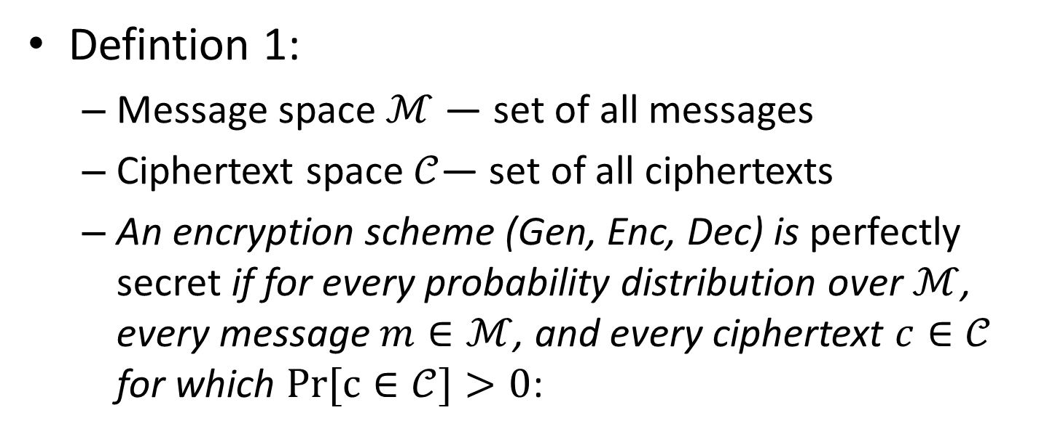
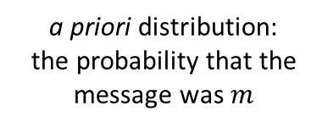
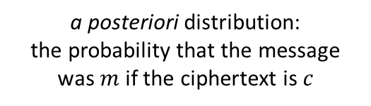
Perfectly Secret Encryption
Defintion 1:
Message space $ℳ$ — set of all messages
Ciphertext space$𝒞$— set of all ciphertexts
An encryption scheme (Gen, Enc, Dec) is perfectly secret if for every probability distribution over $ℳ$, every message $m∈ℳ$, and every ciphertext $c∈𝒞$ for which $Pr⁡[c∈𝒞]>0$:
To simplify the presentation we won’t mention these.
$$\operatorname{Pr}\left[M=m \right|C=c]=Pr⁡[M=m]$$
a posteriori distribution:
the probability that the message was $m$ if the ciphertext is $c$
a priori distribution:
the probability that the message was $m$

Slide 28
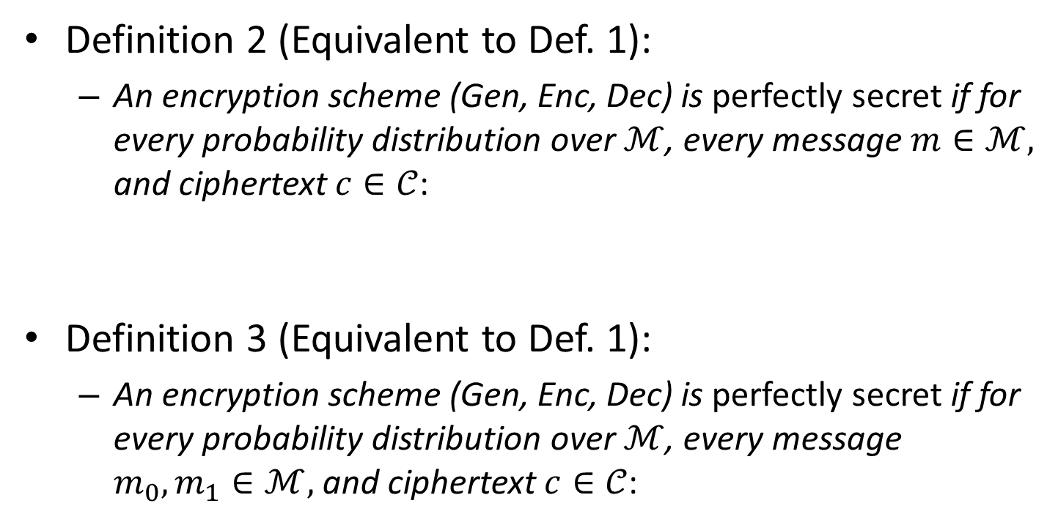

Perfectly-Secret Encryption
Definition 2 (Equivalent to Def. 1):
An encryption scheme (Gen, Enc, Dec) is perfectly secret if for every probability distribution over $ℳ$, every message $m∈ℳ,$ and ciphertext $c∈𝒞$:
Definition 3 (Equivalent to Def. 1):
An encryption scheme (Gen, Enc, Dec) is perfectly secret if for every probability distribution over $ℳ$, every message $m_{0},m_{1}∈ℳ,$ and ciphertext $c∈𝒞$:
$$Pr[{C=c | M=m}]=Pr⁡[C=c]$$
$$Pr[{C=c | M=m_{0}}]=Pr[{C=c | M=m_{1}}]$$

Slide 29


Perfectly Secret Encryption
$$\operatorname{Pr}\left[M=m \right|C=c]=Pr⁡[M=m]$$
$$⟺$$
$$Pr[{C=c | M=m}]=Pr⁡[C=c]$$
$$⟺$$
$$Pr[{C=c | M=m_{0}}]=Pr[{C=c | M=m_{1}}]$$
The distribution over ciphertext is independent of the plaintext, i.e., the ciphertext contains no information about the plaintext.

Slide 30
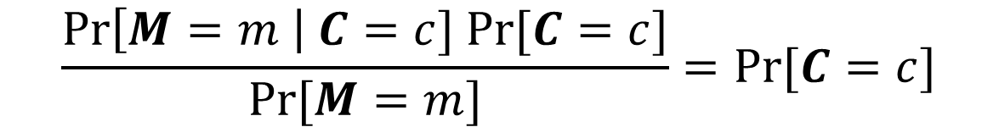
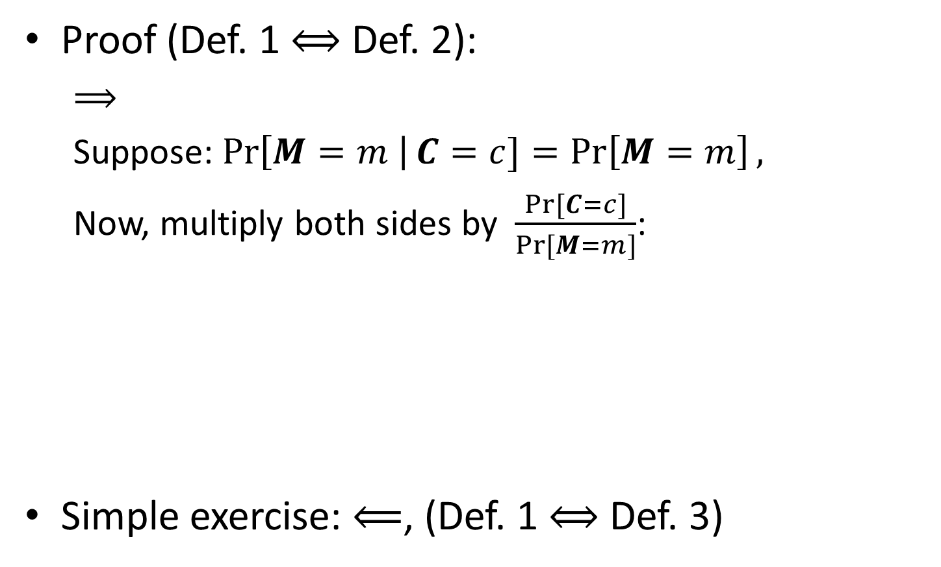
Perfectly Secret Encryption
Proof (Def. 1 $⟺$ Def. 2):
$⟹$
Suppose:$\operatorname{Pr}\left[M=m \right|C=c]=\operatorname{Pr}\left[M=m\right],$
Now, multiply both sides by $\frac{Pr⁡[C=c]}{Pr⁡[M=m]}$:
Simple exercise: $⟸$, (Def. 1 $⟺$ Def. 3)
$$\frac{\operatorname{Pr}\left[M=m \right| C=c] Pr⁡[C=c]}{Pr⁡[M=m]}=Pr⁡[C=c]$$
$Pr[{C=c | M=m}]=Pr⁡[C=c]$ (Bayes’ Theorem)

Slide 31
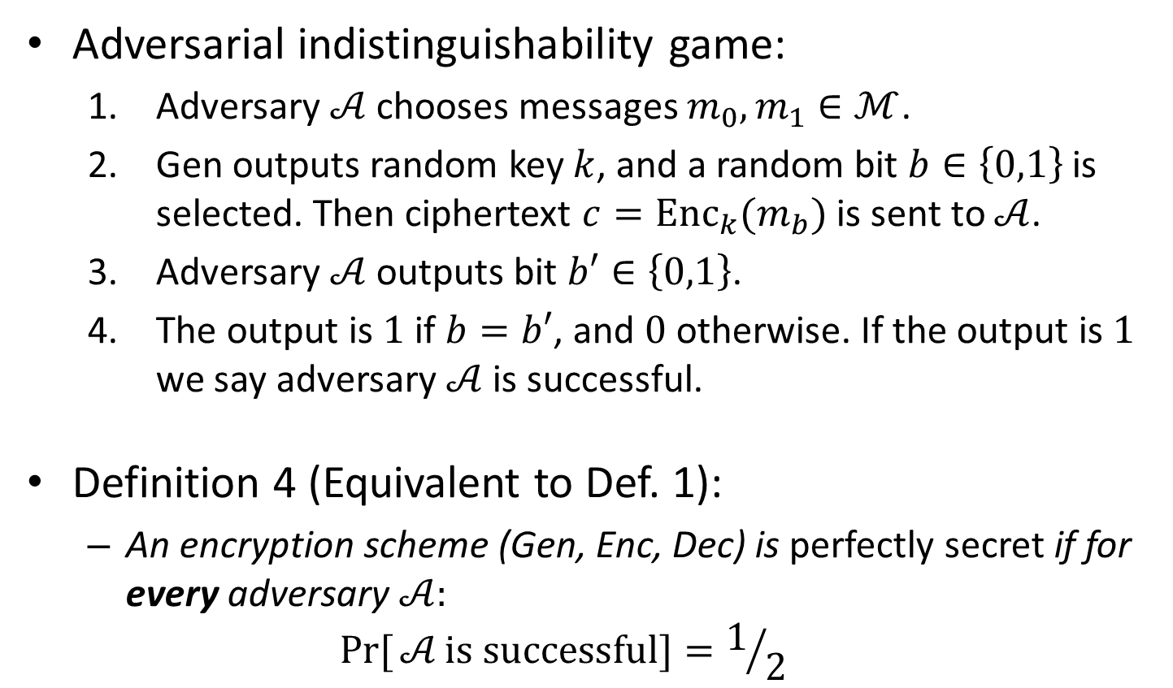
Perfectly Secret Encryption
Adversarial indistinguishability game:
Adversary $𝒜$ chooses messages $m_{0},m_{1}∈ℳ$.
Gen outputs random key $k$, and a random bit $b∈\left\{0,1\right\}$ is selected. Then ciphertext $c={Enc}_{k}(m_{b})$ is sent to $𝒜$.
Adversary $𝒜$ outputs bit $b′∈\left\{0,1\right\}$.
The output is $1$ if $b=b′$, and $0$ otherwise. If the output is $1$ we say adversary $𝒜$ is successful.
Definition 4 (Equivalent to Def. 1):
An encryption scheme (Gen, Enc, Dec) is perfectly secret if for every adversary $𝒜:$
$$Pr[{𝒜}is successful]=1/2$$

Slide 32
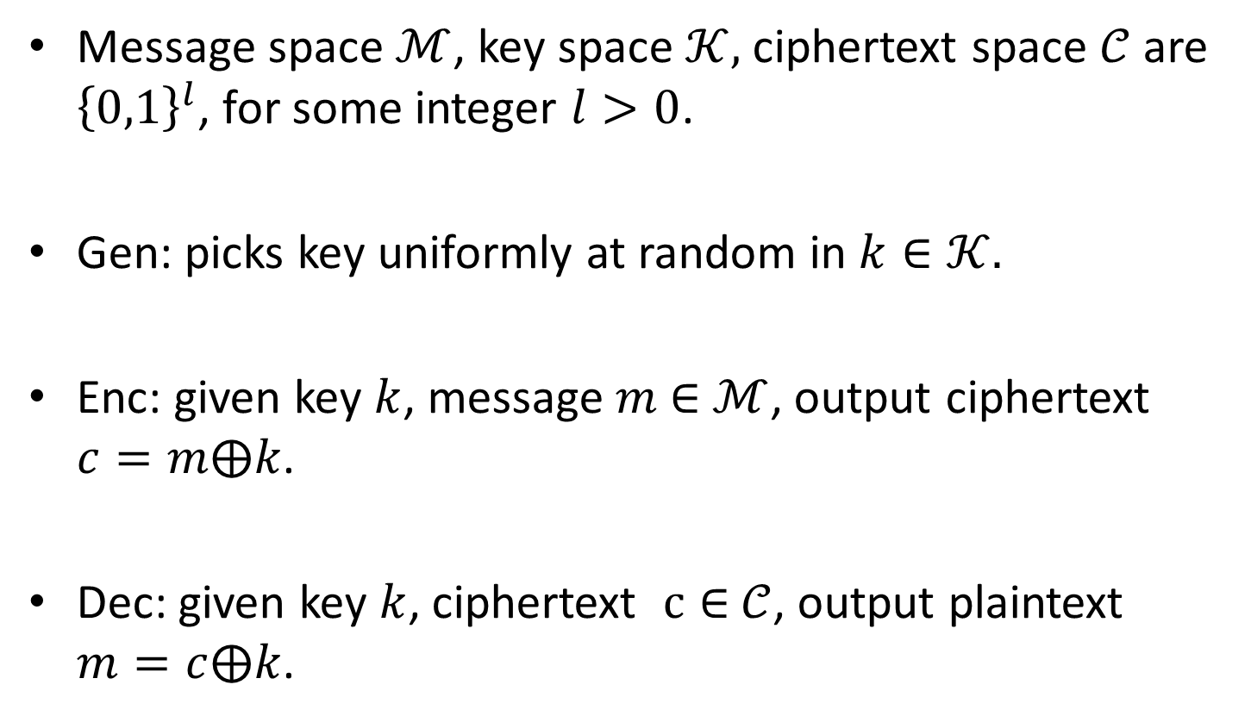
One-Time Pad
Message space $ℳ$, key space $𝒦,$ ciphertext space $𝒞$ are ${\left\{0,1\right\}}^{l}$, for some integer $l>0$.
Gen: picks key uniformly at random in $k∈𝒦.$
Enc: given key $k$, message $m$ $∈$ $ℳ$, output ciphertext $c=m⨁k$.
Dec: given key $k$, ciphertext $c∈$ $𝒞$, output plaintext $m=c⨁k$.

Slide 33
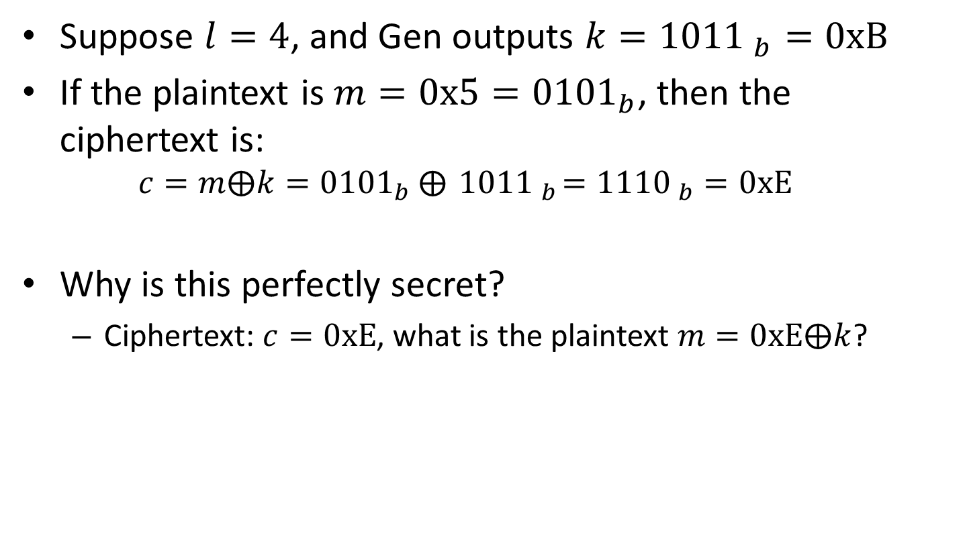
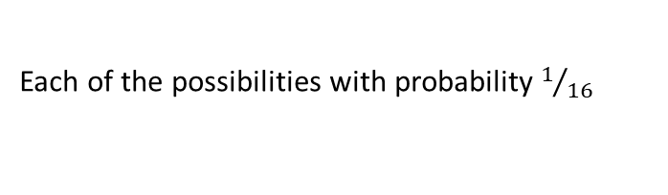
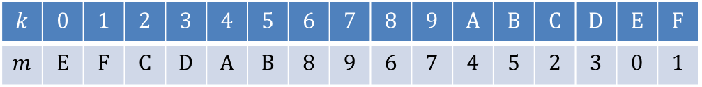
One-Time Pad
Suppose $l=4$, and Gen outputs $k={1011 }_{b}=0xB$
If the plaintext is $m=0x5={0101}_{b}$, then the ciphertext is:
$$c=m⨁k={0101}_{b} ⨁{ 1011 }_{b}={111\text{0} }_{b}=0xE$$
Why is this perfectly secret?
Ciphertext: $c=0xE$, what is the plaintext $m=0xE⨁k$?
$$k$$ | $$0$$ | $$1$$ | $$2$$ | $$3$$ | $$4$$ | $$5$$ | $$6$$ | $$7$$ | $$8$$ | $$9$$ | $$A$$ | $$B$$ | $$C$$ | $$D$$ | $$E$$ | $$F$$
$$m$$ | $$E$$ | $$F$$ | $$C$$ | $$D$$ | $$A$$ | $$B$$ | $$8$$ | $$9$$ | $$6$$ | $$7$$ | $$4$$ | $$5$$ | $$2$$ | $$3$$ | $$0$$ | $$1$$
Each of the possibilities with probability $1/{16}$

Slide 34
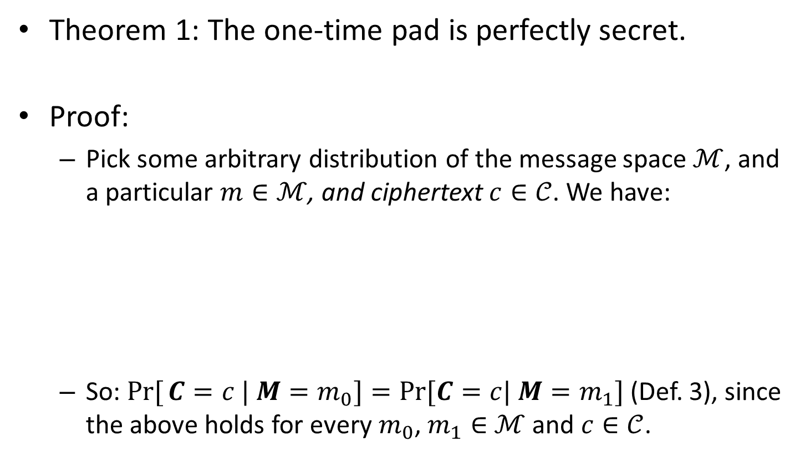


One-Time Pad
Theorem 1: The one-time pad is perfectly secret.
Proof:
Pick some arbitrary distribution of the message space $ℳ$, and a particular $m∈ℳ$, and ciphertext $c∈𝒞$. We have:
So: $Pr[{C=c | M=m_{0}}]=Pr⁡[C=c| M=m_{1}]$ (Def. 3), since the above holds for every $m_{0}$, $m_{1}∈$ $ℳ$ and $c∈𝒞$.
$Pr[{C=c | M=m}]=\operatorname{Pr}\left[M⨁K=c | M=m\right]$
$=Pr{[m⨁K=c]}$
$=Pr\left[K=m⨁c\right]=2^{−l}$

Slide 35
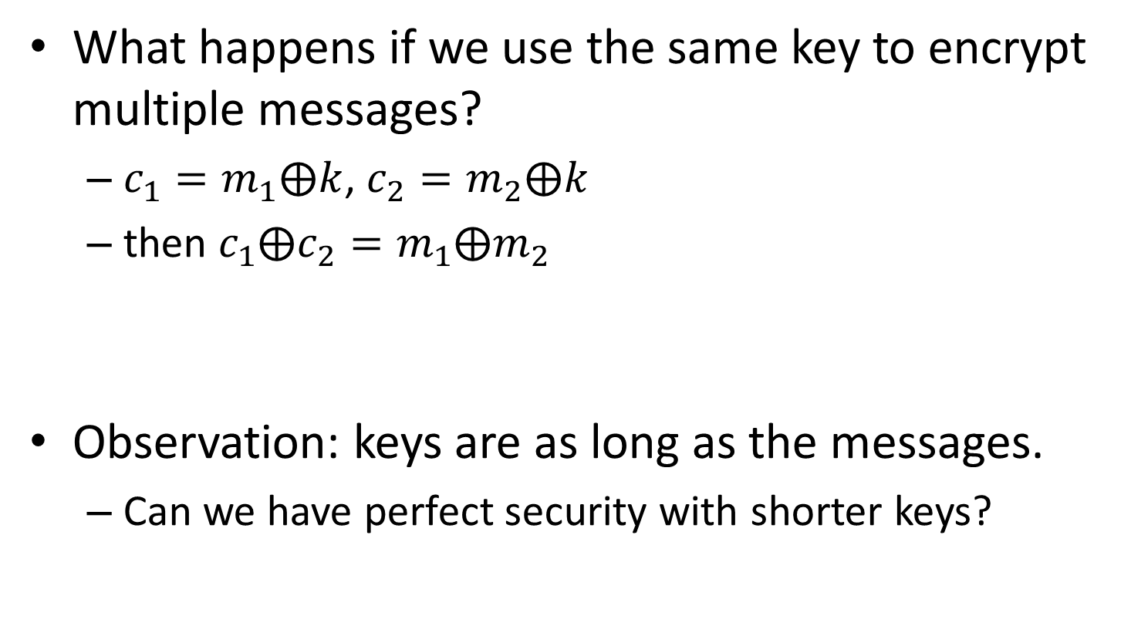
One-Time Pad
What happens if we use the same key to encrypt multiple messages?
$c_{1}=m_{1}⨁k$, $c_{2}=m_{2}⨁k$
then ${c_{1}⨁c}_{2}=m_{1}⨁m_{2}$
Observation: keys are as long as the messages.
Can we have perfect security with shorter keys?

Slide 36






Perfectly Secret Encryption
$$ℳ$$
$$𝒞$$
$$M(c)$$
$$m′$$
Enc
$$c$$
Enc
$$𝒦$$
Observe that $\left|M\left(c\right)\right|≤\left|𝒦\right|$, but since $\left|𝒦\right|<\left|ℳ\right|$, there exists $m′∈ℳ∖M\left(c\right)$

Slide 37
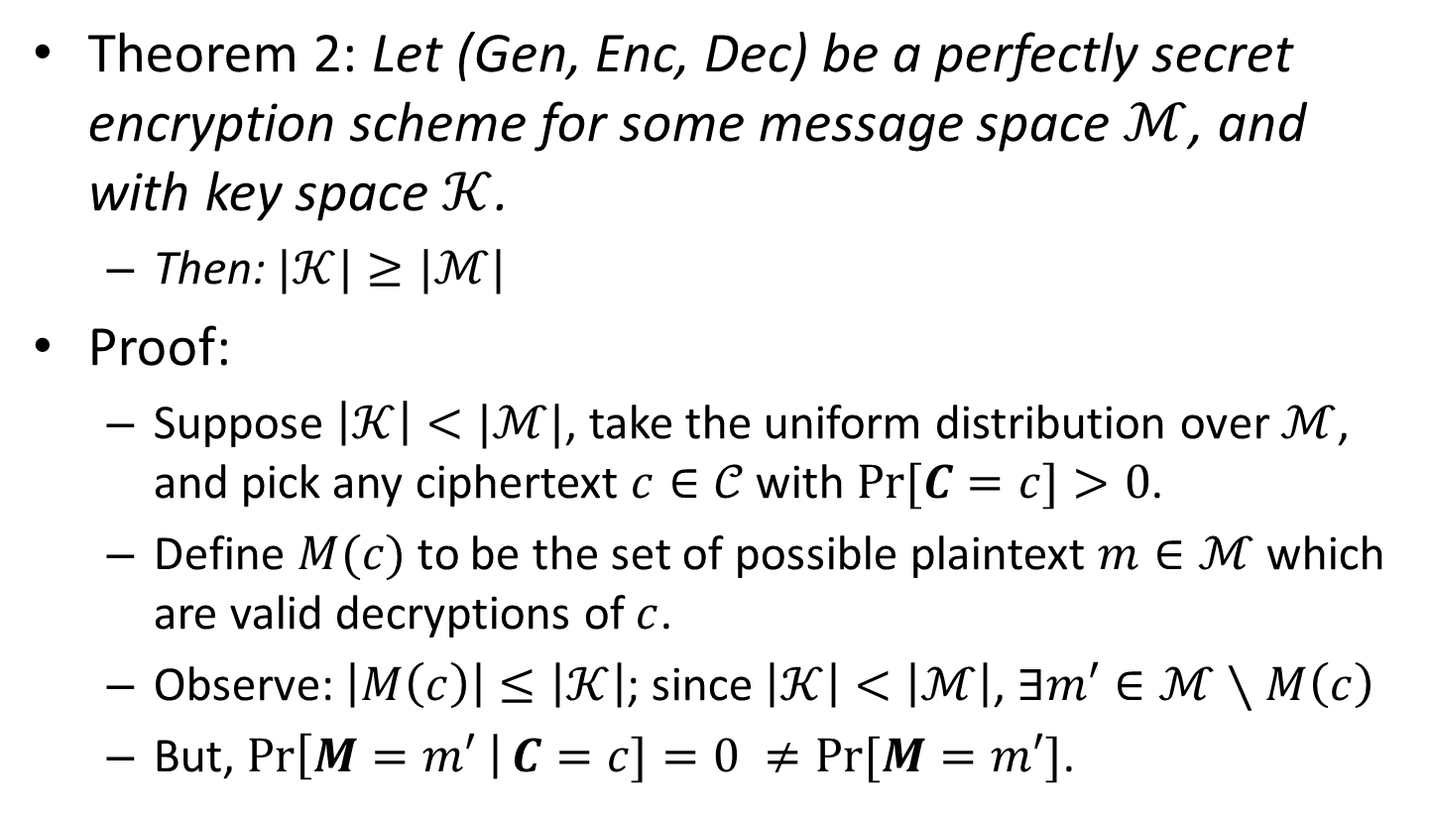
Perfectly Secret Encryption
Theorem 2: Let (Gen, Enc, Dec) be a perfectly secret encryption scheme for some message space $ℳ$, and with key space $𝒦$.
Then: $|𝒦|≥|ℳ|$
Proof:
Suppose $\left|𝒦\right|<|ℳ|$, take the uniform distribution over $ℳ$, and pick any ciphertext $c∈𝒞$ with $Pr⁡[C=c]>0$.
Define $M(c)$ to be the set of possible plaintext $m∈ℳ$ which are valid decryptions of $c$.
Observe: $\left|M\left(c\right)\right|≤\left|𝒦\right|$; since $\left|𝒦\right|<\left|ℳ\right|$, $∃m′∈ℳ∖M\left(c\right)$
But, $\operatorname{Pr}\left[M=m′ \right|C=c]=0 ≠Pr⁡[M=m′]$.

Slide 38
Symmetric-Key Encryption
Schemes used in practice are not perfectly secure, but only computationally secure
Key space (e.g., 128 bits) is much smaller than plaintext space (i.e., virtually unlimited)
Use modes of operations to encrypt arbitrary length messages using block ciphers (which operate on fixed-length chunks)

Slide 39
References
Jonathan Katz, and Yehuda Lindell. "Introduction to modern cryptography." CRC Press, 2014. Chapters 1 and 2.

Slide 40
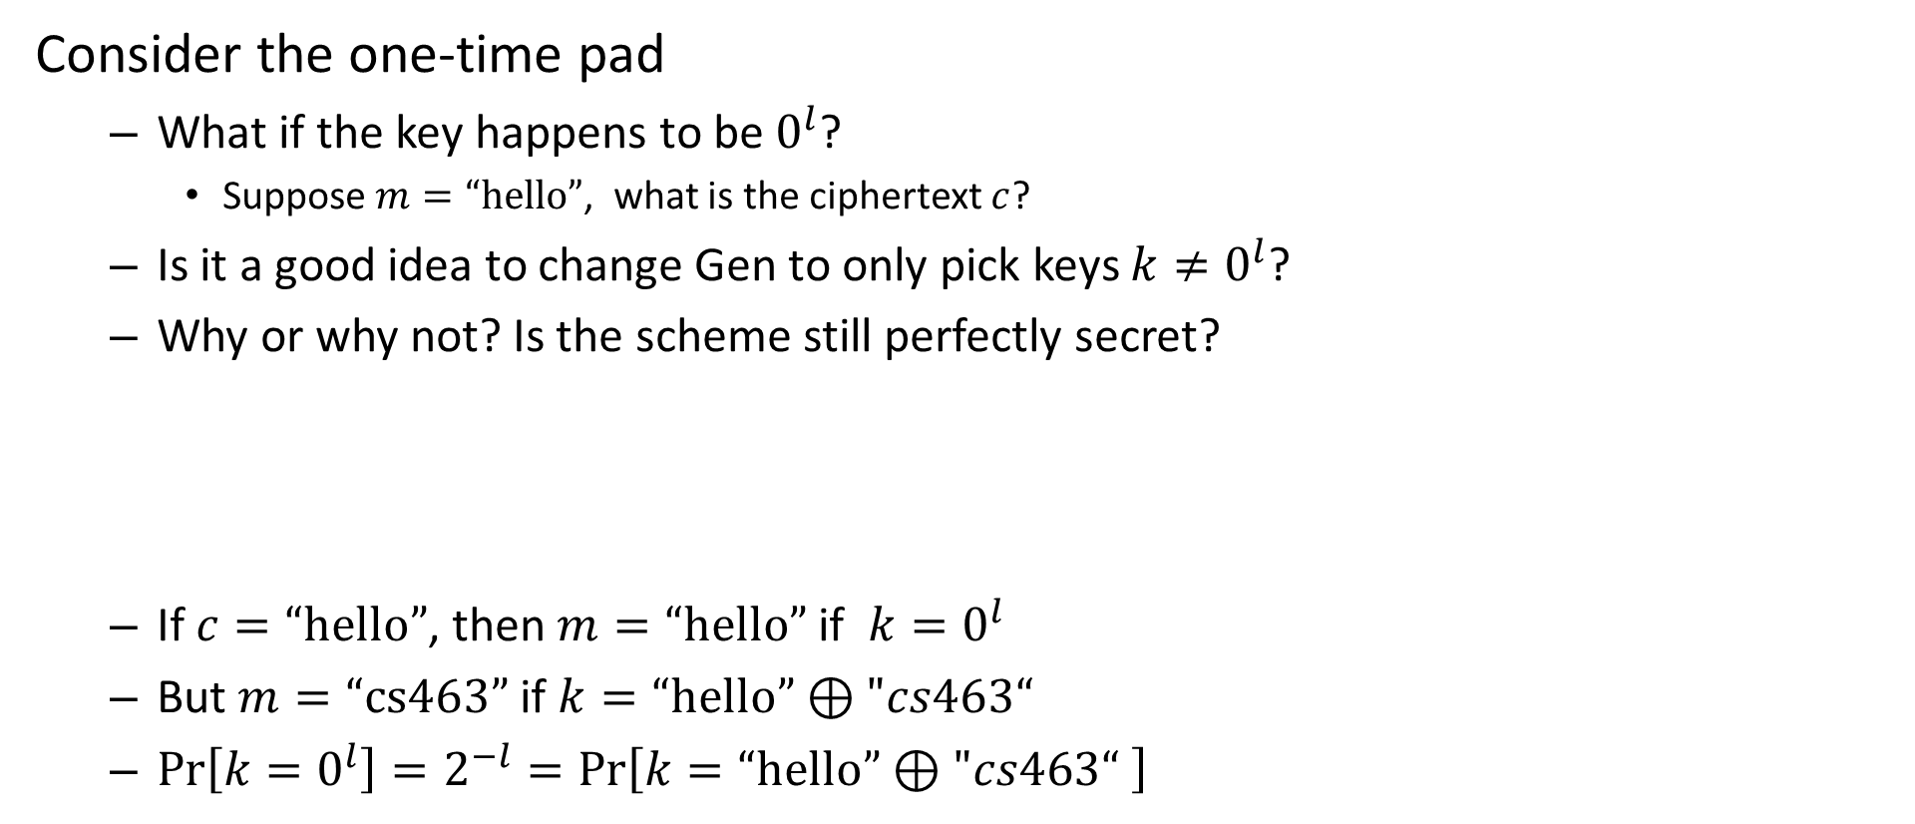
Question
Consider the one-time pad
What if the key happens to be $0^{l}$?
Suppose $m=“hello”$, what is the ciphertext $c$?
Is it a good idea to change Gen to only pick keys $k≠0^{l}$?
Why or why not? Is the scheme still perfectly secret?
If $c=“hello”$, then $m=“hello”$ if $k=0^{l}$
But $m=“cs463”$ if $k=“hello”⊕"cs463“$
$\operatorname{Pr}\left[k=0^{l}\right]=2^{−l}=\operatorname{Pr}\left[k=“hello”⊕"cs463“ \right]$

Slide 41
463.8.3 Computational Security
Computer Security II
CS463/ECE424
University of Illinois

Slide 42
Computational Security
Another Kerckhoffs Security Principle
“The [cryptosystem] should be, if not theoretically unbreakable, unbreakable in practice.”
Basic idea: a scheme does not need to be perfectly secret, but only:
Not breakable within a reasonable amount of time
Not breakable with a reasonable probability of success
Notes:
Six principles: see https://en.wikipedia.org/wiki/Auguste_Kerckhoffs

Slide 43
Computational Security
We require:
Security against efficient an adversary running in a feasible amount of time.
Adversary may succeed with some very small probability.
We need to precisely define:
Efficient adversary
Feasible amount of time
Very small probability

Slide 44
Computational Security
There are two common approaches for formalization:
Concrete approach
Asymptotic approach

Slide 45
Concrete Approach
(Template) Definition:
Let $t,ε>0$, with $ε≤1$.
A scheme is ($t$, $ε$)-secure if every adversary running for time at most $t$ breaks the scheme with probability at most $ε$.
What does it mean to “break” the scheme?
What is the time unit?

Slide 46
Concrete Approach
Example (optimal security):
Modern encryption schemes with key length of $n$ bits and adversary running in time $t$, are breakable with probability at most $t{× 2}^{−n}$
Brute-force attack: try to decrypt using all${ 2}^{n}$ keys
It may be useful to think of the time unit as being either:
Clock cycle
Time to invoke the decryption function

Slide 47
Concrete Approach
How to get a feeling for $t,ε$?
Nowadays, computation on the order of ${t=2}^{64}$is barely within reach.
A 4GHz computer will take roughly 146 years to execute for $2^{64}$ cycles.
Parallelization: with 146 such computers it would take only about one year
Assume $n=128$ bits
If an adversary runs a 4GHz computer for 146 years can break a modern encryption scheme (e.g., AES) with probability at most $2^{−64}$.
Is probability $2^{−64}$ small enough?

Slide 48
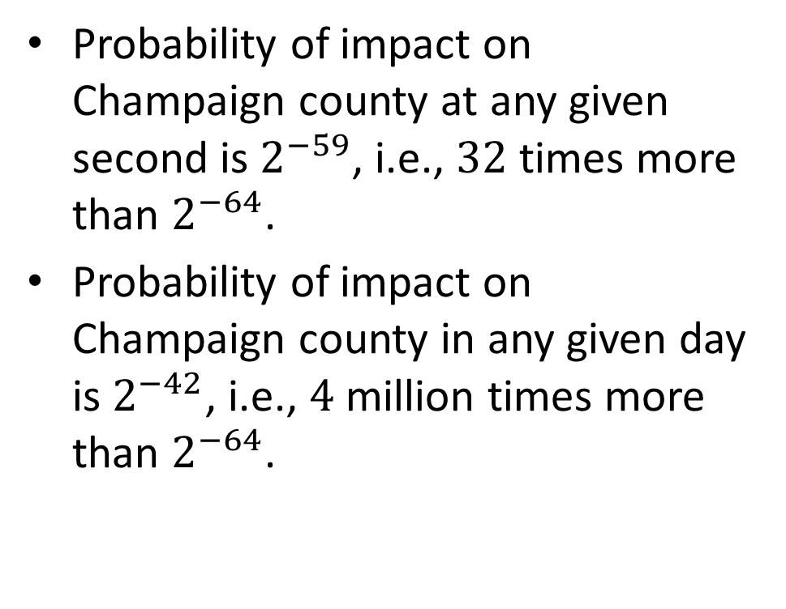
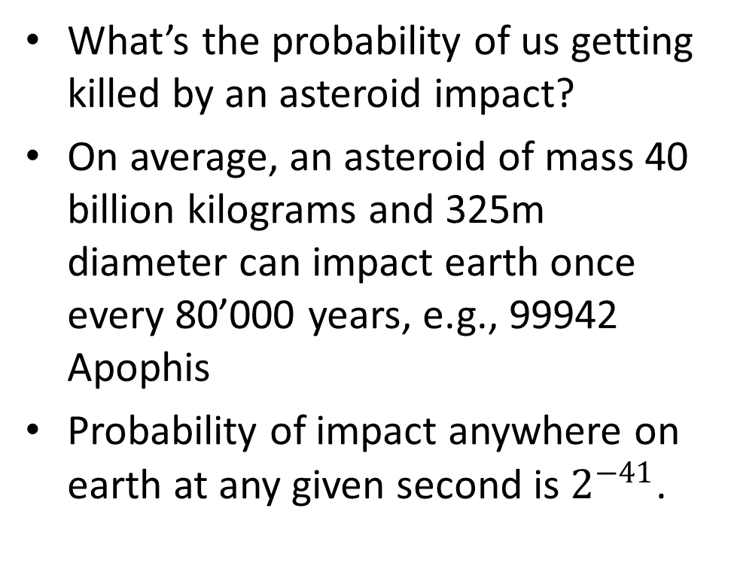
Asteroid Impact
What’s the probability of us getting killed by an asteroid impact?
On average, an asteroid of mass 40 billion kilograms and 325m diameter can impact earth once every 80’000 years, e.g., 99942 Apophis
Probability of impact anywhere on earth at any given second is $2^{−41}$.
Probability of impact on Champaign county at any given second is $2^{−59}$, i.e., $32$ times more than $2^{−64}$.
Probability of impact on Champaign county in any given day is $2^{−42}$, i.e., $4$ million times more than $2^{−64}$.

Slide 49
Concrete Approach
The approach is useful but we should be careful:
For what values of $t,ε$ can we say the scheme is “secure”?
What are the capabilities of the adversary?
Hardware: “off-the-shelf” or custom-built?
Algorithms & Software: “off-the-shelf” or designed for the attack?
What about Moore’s law?
Computing power doubles every 18 months
Attack now or later?
Now: 146 computer (4GHz) run for 1 years to break AES-128 with probability at most $2^{−64}$.
Later (in $18 × 64$months$= 96$years): 146 computers (of the future) run for one year to break AES-128 with probability 1.

Slide 50
Asymptotic Approach
Basic idea:
Use complexity theory
Running time and success probability of the adversary are functions (of some parameters), not concrete numbers
Formally, we define a security parameter

Slide 51
Asymptotic Approach
Security parameter:
For encryption: the key length, i.e., for encryption with an $n$-bit key, we say the security parameter is $n$.
Efficiency:
Honest parties and feasible adversaries runs in PPT (in $n$).
PPT stands for probabilistic polynomial time, i.e., $a×n^{c}$ for some constants $a$ and $c$.
Probability of success:
Must be smaller than any inverse polynomial, i.e., $n^{−c}$ for every constant $c$. This is called a negligible probability.

Slide 52
Asymptotic Approach
Concretely (for large enough values of n):
Running times of $n^{2}$, $n^{10}$, and even $n^{1000}$ are all feasible.
Running times of $2^{n}$, $2^{\sqrt{n}}$, and even $n^{\log{n}}$ are all infeasible.
$2^{−n}$, $2^{−\sqrt{n}}$ and $n^{−\log{n}}$ are all negligible probabilities.

Slide 53
Asymptotic Approach
(Template) Definition:
A scheme is secure if every adversary running in PPT succeeds in breaking the scheme with only negligible probability.
Remarks:
The security only holds for large enough values of the security parameter.
We will use the asymptotic approach in the rest of the lecture.

Slide 54
Asymptotic Approach
Example:
Take a secure scheme with security parameter $n$
Suppose there is an adversary can break the scheme running for $n^{3}$ minutes with probability $2^{40}×2^{−n}$.
Since $2^{−n+40}$ is a negligible function, the definition is satisfied
However, if we take $n=40$, then the adversary can break the scheme by running for ${40}^{3}$ minutes $≅6$ weeks, with probability 1.

Slide 55
Computational Security
Observation: we have relaxed the security in two ways
We restrict the running time of the adversary to be polynomial (in terms of the security parameter)
We allow the adversary to successfully break the scheme with some very small (i.e., negligible) probability
Why?
because we are using short keys, i.e., $|𝒦|≪|ℳ|$.

Slide 56
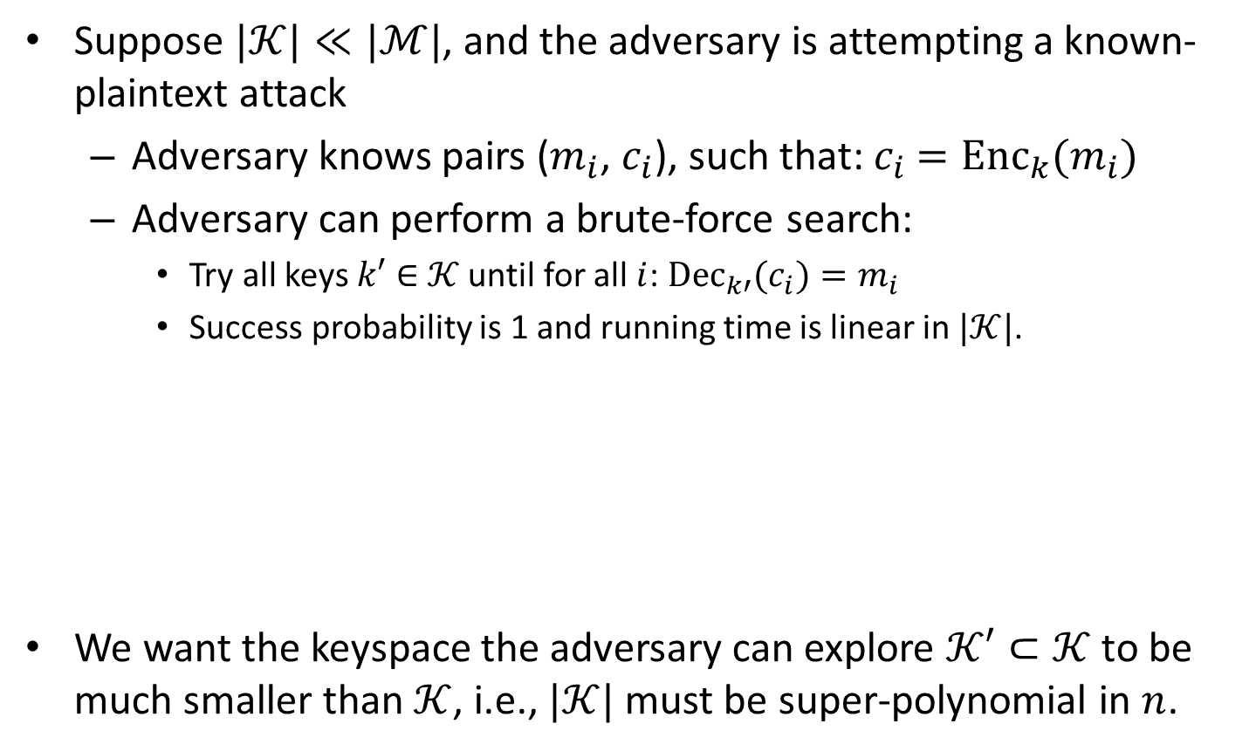
Running Time
Suppose $|𝒦|≪|ℳ|$, and the adversary is attempting a known-plaintext attack
Adversary knows pairs ($m_{i}$, $c_{i}$), such that:${ c}_{i} ={{Enc}_{k}(m}_{i})$
Adversary can perform a brute-force search:
Try all keys $k′∈$ $𝒦$ until for all $i$: ${{Dec}_{k′}(c}_{i})=m_{i}$
Success probability is 1 and running time is linear in $|𝒦|$.
We want the keyspace the adversary can explore $𝒦′⊂𝒦$ to be much smaller than $𝒦$, i.e., $|𝒦|$ must be super-polynomial in $n$.
$$𝒦$$
$$𝒦′$$

Slide 57
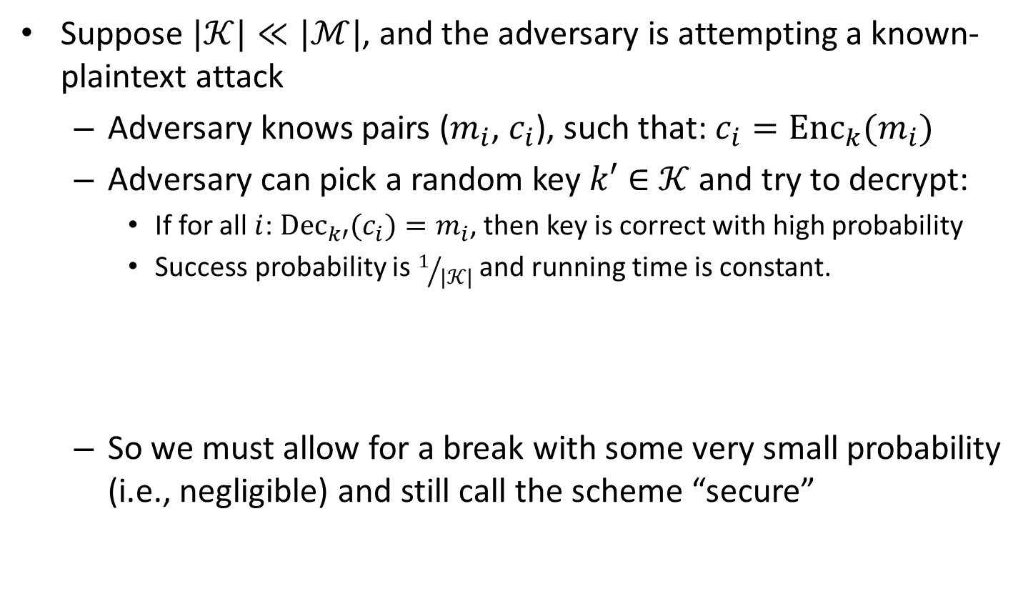
Success Probability
Suppose $|𝒦|≪|ℳ|$, and the adversary is attempting a known-plaintext attack
Adversary knows pairs ($m_{i}$, $c_{i}$), such that: $c_{i}={{Enc}_{k}(m}_{i})$
Adversary can pick a random key $k′∈$ $𝒦$ and try to decrypt:
If for all $i$: ${{Dec}_{k′}(c}_{i})=m_{i}$, then key is correct with high probability
Success probability is $1/{|𝒦|}$ and running time is constant.
So we must allow for a break with some very small probability (i.e., negligible) and still call the scheme “secure”

Slide 58
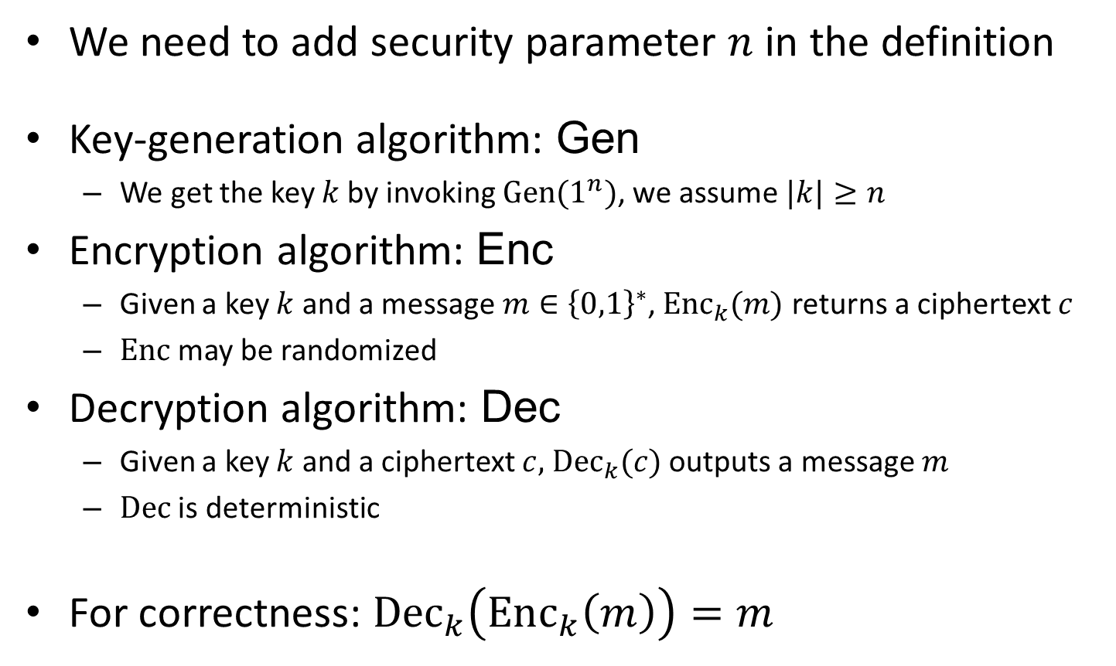
Computationally Secure Encryption
We need to add security parameter $n$ in the definition
Key-generation algorithm: Gen
We get the key $k$by invoking $Gen(1^{n})$, we assume $|k|≥n$
Encryption algorithm: Enc
Given a key $k$ and a message $m∈{\left\{0,1\right\}}^{∗}$, ${Enc}_{k}(m)$ returns a ciphertext $c$
$Enc$ may be randomized
Decryption algorithm: Dec
Given a key $k$ and a ciphertext $c,$ ${Dec}_{k}(c)$ outputs a message $m$
$Dec$ is deterministic
For correctness: ${Dec}_{k}\left({Enc}_{k}\left(m\right)\right)=m$

Slide 59
Recall: Perfectly Secret Encryption
Adversarial indistinguishability game:
Adversary $𝒜$ chooses messages $m_{0},m_{1}∈ℳ$.
Gen outputs random key $k$, and a random bit $b∈\left\{0,1\right\}$ is selected. Then ciphertext $c={Enc}_{k}(m_{b})$ is sent to $𝒜$.
Adversary $𝒜$ outputs bit $b′∈\left\{0,1\right\}$.
The output is $1$ if $b=b′$, and $0$ otherwise. If the output is $1$ we say adversary $𝒜$ is successful.
Definition 4 (Equivalent to Def. 1):
An encryption scheme (Gen, Enc, Dec) is perfectly secret if for every adversary $𝒜:$
$$Pr[{𝒜}is successful]=1/2$$

Slide 60
Computationally Secure Encryption
Eavesdropper indistinguishability game:
Adversary $𝒜$ is given input $1^{n}$ and chooses messages $m_{0},m_{1}∈ℳ$ of the same length.
$Gen(1^{n})$ outputs random key $k$, and a random bit $b∈\left\{0,1\right\}$ is selected. Then $c={Enc}_{k}(m_{b})$, called the challenge ciphertext, is sent to $𝒜$.
Adversary $𝒜$ outputs bit $b′∈\left\{0,1\right\}$.
The output is $1$ if $b=b′$, and $0$ otherwise. If the output is $1$ we say adversary $𝒜$ is successful.
Definition:
An encryption scheme (Gen, Enc, Dec) has indistinguishable encryption (in the presence of an eavesdropper) if for all PPT adversaries $𝒜$ there exists a negligible function negl such that:
$$Pr[{𝒜}is successful]≤1/2+negl(n)$$

Slide 61
463.8.4 Pseudorandom Generators
Computer Security II
CS463/ECE424
University of Illinois

Slide 62
Pseudorandomness
Roughly speaking, a pseudorandom string “looks” random as long as the “looking” entity runs in PPT.
Any PPT algorithm cannot distinguish between a truly random string and a pseudorandom string.
Remarks:
Pseudorandomness is a computational relaxation of randomness
If we say a string is pseudorandom we really mean: the process generating this string is pseudorandom

Slide 63
Pseudorandomness & Encryption
Intuition:
With the one-time pad, the ciphertext was truly random because the key was picked uniformly at random
If we use pseudorandomness we can make the ciphertext look random to any PPT adversary
If we can generate a long pseudorandom string from a small truly random seed, a small key will suffice

Slide 64
Pseudorandom Generators (PRGs)
Roughly speaking:
A PRG is a deterministic algorithm that receives a short truly random seed and stretches it into a long pseudorandom string.
In other words, a PRG uses a small amount of true randomness in order to generate a large amount of pseudorandomness.
To formally define PRGs, we will need the notion of distinguishers
A distinguisher $D$ is an algorithm which receives an input string $u$ and outputs a bit $b∈\left\{0,1\right\}$. Its goal is to determine whether its input $u$ is random string.

Slide 65
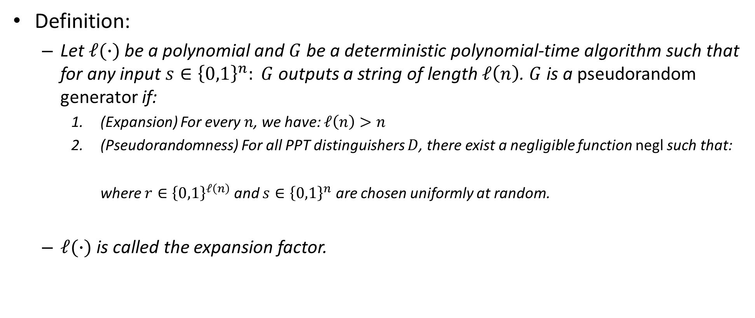
PRGs
Definition:
Let $ℓ(∙)$be a polynomial and $G$ be a deterministic polynomial-time algorithm such that for any input $s∈{\left\{0,1\right\}}^{n}: G$ outputs a string of length $ℓ\left(n\right)$. $G$ is a pseudorandom generator if:
(Expansion) For every $n$, we have: $ℓ\left(n\right)>n$
(Pseudorandomness) For all PPT distinguishers $D$, there exist a negligible function negl such that:
where $r∈{\left\{0,1\right\}}^{ℓ\left(n\right)}$ and $s∈{\left\{0,1\right\}}^{n}$ are chosen uniformly at random.
$ℓ(∙)$ is called the expansion factor.
$$\left|\operatorname{Pr}\left[D\left(r\right)=1\right]−\operatorname{Pr}\left[D\left(G\left(s\right)\right)=1\right]\right|≤negl\left(n\right),$$
Notes:
Definition 3.14

Slide 66


PRGs
How random is the output of a PRG?
Suppose we have a PRG with $ℓ\left(n\right)=2n$
The seed is $n$ bit long but the output is a $2n$ bit string
Probability that a random output string is in the range of G: $2^{−n}$
seed
output
$${\left\{0,1\right\}}^{n}$$
$${\left\{0,1\right\}}^{2n}$$
G

Slide 67
Existence of PRGs
Do PRGs exist?
We do not know
We believe they do exist: under the assumption that one-way functions exist, we can construct PRGs.
One-way functions are functions $f$, for which it is easy to compute $f(x)$, but hard to compute $f^{−1}(y)$

Slide 68
Secure Fixed-Length Encryption
Let $G$ be a PRG with expansion factor $ℓ$
Let key $k$, message $m$, and ciphertext $c$
$k$ is $n$ bits; $m$and $c$ are $ℓ(n)$ bits
Gen:
Generate a uniformly random $n$-bit key $k$, i.e., with probability $2^{−n}$
Enc:
Compute $c=G(k)⨁m$
Dec:
Compute $m=G(k)⨁c$

Slide 69
Secure Fixed-Length Encryption
Theorem:
If $G$ is a PRG, then the fixed-length encryption scheme is secure, i.e., it has indistinguishable encryptions in the presence of an eavesdropper.
Proof (by reduction):
We will show that if an adversary can break our fixed-length encryption scheme, then we can construct a distinguisher, i.e., an algorithm which can distinguish output of $G$ from a truly random string.
Notes:
Theorem 3.18

Slide 70
Proof (Sketch)
If we replace our $G$ with a truly random generator, then our scheme is identical to the one-time pad.
And so no adversary can succeed with probability better other than $1/2$
So, if a PPT adversary $𝒜$ can break the fixed-length encryption scheme, then the adversary must be implicitly distinguishing the output of $G$ from a truly random string.
This is the key part of the proof, where we construct a distinguisher $D$ using $𝒜$
This implies that $G$ is not a PRG, which contradicts our starting assumption.
Therefore, the scheme is secure.

Slide 71
Computationally Secure Encryption
Eavesdropper indistinguishability game:
Adversary $𝒜$ is given input $1^{n}$ and chooses messages $m_{0},m_{1}∈ℳ$ of the same length.
$Gen(1^{n})$ outputs random key $k$, and a random bit $b∈\left\{0,1\right\}$ is selected. Then $c={Enc}_{k}(m_{b})$, called the challenge ciphertext, is sent to $𝒜$.
Adversary $𝒜$ outputs bit $b′∈\left\{0,1\right\}$.
The output is $1$ if $b=b′$, and $0$ otherwise. If the output is $1$ we say adversary $𝒜$ is successful.
Definition:
An encryption scheme (Gen, Enc, Dec) has indistinguishable encryption (in the presence of an eavesdropper) if for all PPT adversaries $𝒜$ there exists a negligible function negl such that:
$$Pr[{𝒜}is successful]≤1/2+negl(n)$$

Slide 72
Reduction
We are given a PPT adversary $𝒜$
Distinguisher $D$:
On input $u∈{\left\{0,1\right\}}^{ℓ\left(n\right)}$, do the following:
Run $𝒜(1^{n})$ to obtain messages $m_{0},m_{1}∈{\left\{0,1\right\}}^{ℓ\left(n\right)}$
Select a random bit $b∈\left\{0,1\right\}$, and compute ${c=u⨁m}_{b}$
Send ciphertext $c$ to $𝒜$ and obtain bit $b$’. Output is $1$ if $b=b′$, and $0$ otherwise
Observation:
If $u$ is a random string then $𝒜$ is being run against the one-time pad, and so $𝒜$ will be successful with probability $1/2$
If $u=G(k)$, for some key $k$ then $\operatorname{Pr}\left[D\left(G\left(k\right)\right)=1\right]=Pr[{𝒜}is successful]$

Slide 73
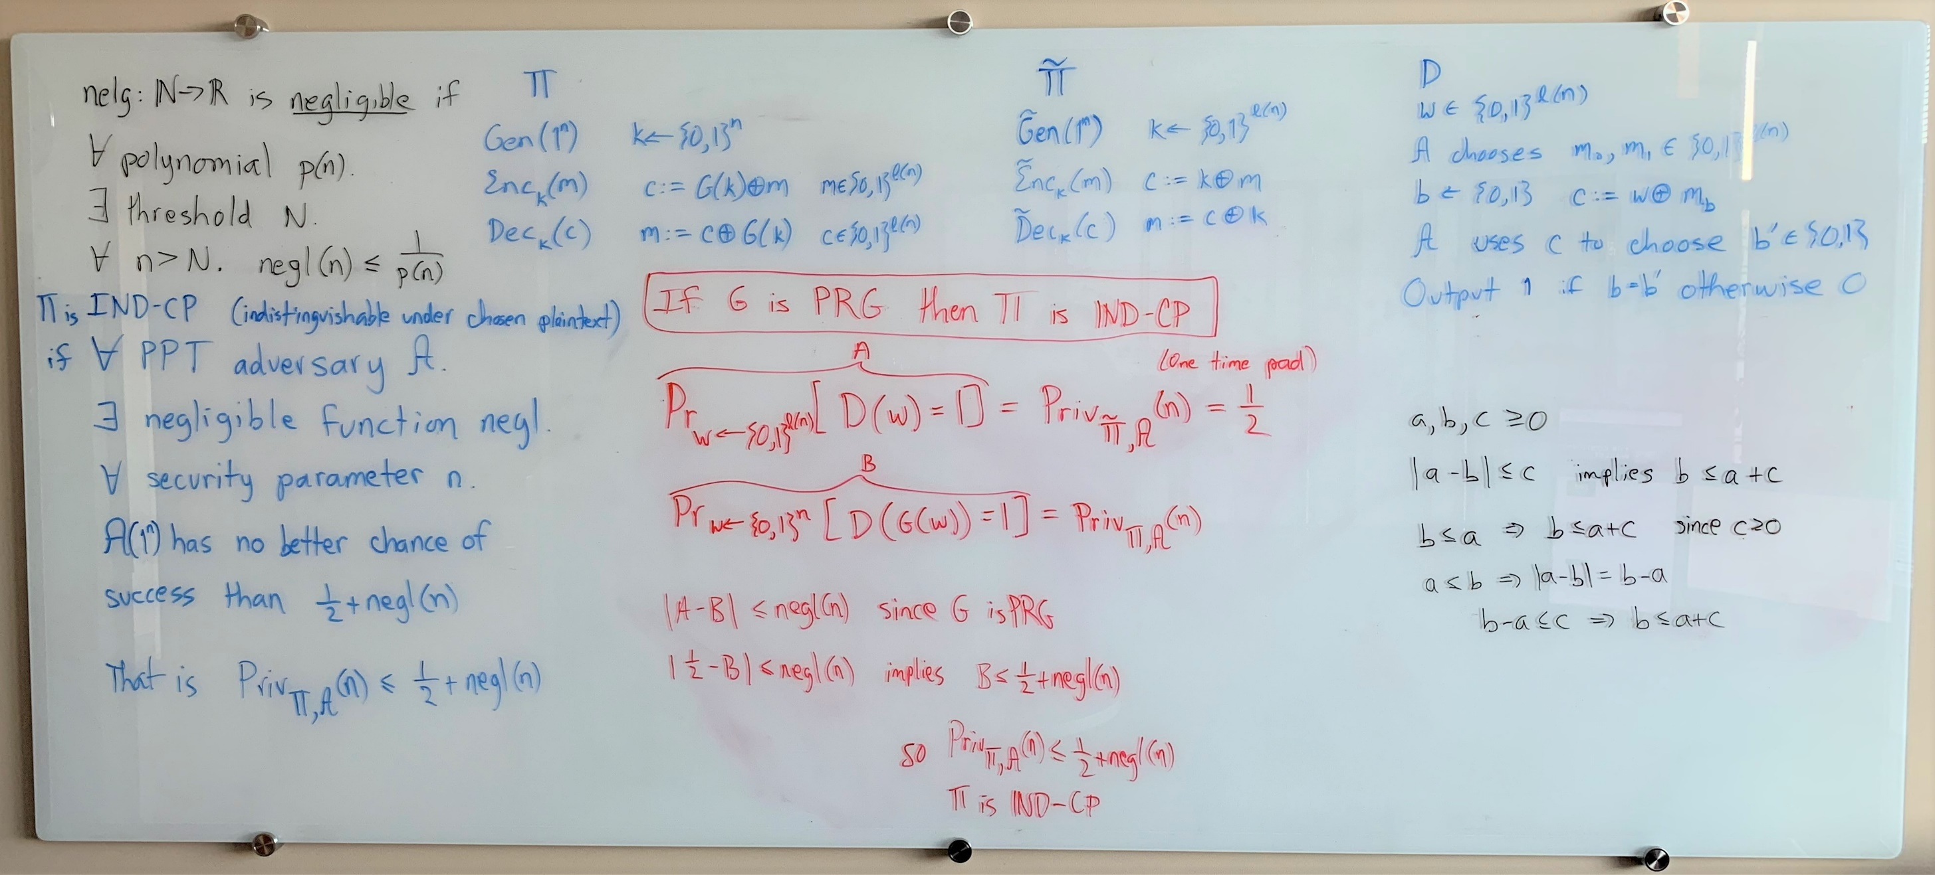
Proof by White Board Picture

Slide 74
References
Jonathan Katz, and Yehuda Lindell. "Introduction to modern cryptography." CRC Press, 2014. First half of Chapter 3 (up to Theorem 3.18)

Slide 75
Science of Security
T5
T6
Physics-envy is counterproductive; seeking “laws of cybersecurity” similar to physics is likely to be a fruitless search.
Crypto-envy is counterproductive; many areas of security, including those involving empirical research, are less amenable to formal treatment or mathematical role models.
Herley, Cormac, and Paul C. Van Oorschot.
"Sok: Science, security and the elusive goal of security as a scientific pursuit."
In 2017 IEEE Symposium on Security and Privacy (SP), pp. 99-120. IEEE, 2017.

